Slide 1


Slide 2

Meet the Teachers
Ms. C.Chen (Chinese Teacher)
Second year teaching 1st grade!
Enjoy cooking and shopping in antique stores.
Can’t say no to dessert
Ms. Russo(English Teacher)
This is my 32nd year to teach and 2nd year a MIMS. Most years were spent in ELA Middle School, but I just to love read and share stories with kids. I spend my spare time with my 4 dogs, family and friends. Originally, from New York but raised here. I also cannot say “no” to dessert!

Slide 3

Attendance
If your child is going to be absent, please let the front office know. At the same time, email us or send a note with your child when he/she returns.
Tardy Policy
Children who arrive to the classroom after 8:35 AM will be considered tardy.
Transportation
If there is a change in transportation, please email:
MIMSDismissal@houstonisd.org
Emails must be received no later than 3:15 pm.

Slide 4
EARLY DEPARTURE PICK-UP
If you need to pick up your child prior to dismissal time, please come to the front office before 3:30 pm. The person picking up the student must show his/her driver’s license and be listed in HISD system. Designated adults who are not in the system must present a written permission or email from the parents.

Slide 5

White Daily Binder
Homework will be in the folder.
The binder should be returned to school daily.
Red Tuesday Folder
Graded assignments will be sent home in the Tuesday folder.
Important information from MIMS will be sent home on Tuesdays as well.
Please initial conduct chart weekly.

Slide 6
Conduct
Color System as in MIMS Student Code of Conduct
  Student’s conduct begins on Green (Satisfactory)and can move up to Purple (xcellent) or down yellow (poor) and red (unsatisfactory).
  Weekly chart home starting soon and will be in Tuesday folders.
  Classes are using Dojo which is an incentive program to encourage positive behavior. It is fluid program that gives students the opportunity to make better choices during the day ☺

Slide 7
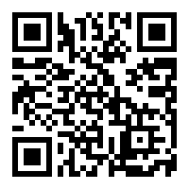
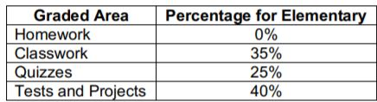
Grades
Students will have tests on Monday in Chinese classes and Fridays for ELA and SS.
Create an account on Gradespeed and check your child’s grades weekly.
If your child makes below a 70% on a test, you must sign and return the test for your child to retake. Highest grade possible is a 70%.

Slide 8
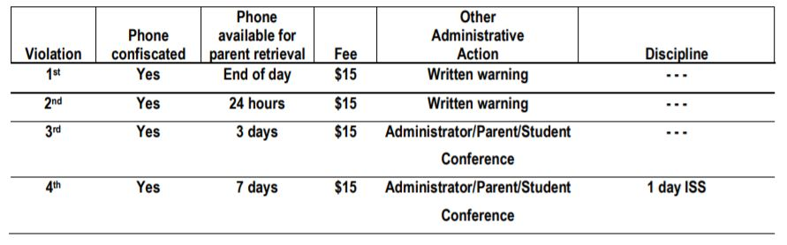
CELL PHONE AND ELECTRONIC DEVICE POLICY

Slide 9
Goals
Understand all first grade objectives with a grade of 70% or higher
Reading Level J at the end of first grade
Pass both English and Chinese First Grade High Frequency Word Evaluations with 70%.
If a student who passed the Chinese HFW BOY and MOY tests, but did not pass the HFW EOY test, the student is required to go to summer school.

Slide 10
Homework
All homework is sent home in white binders on Monday.
It is due the following Monday and must have student’s name and turned on time.

Slide 11
Chinese/Math/Science
Body language, visual aids
Mini-lesson as a class
  Interactive read aloud with accountable talk
  Sentence structure practice
  Guided practice and activities
  Hands-on activities to master concepts
Small group and workstations
Experiments

Slide 12
Chinese/Math/Science
Math: Go Math
Science: Science Fusion
Chinese: My First Chinese Reader Vol. 1- Simplified Chinese Characters
Quizlet: https://quizlet.com/join/QAeVwPNu4
Need to know 139 high frequency words
Better Chinese online learning:
http://online.betterchinese.com/Login.aspx
ClassDojo

Slide 13
Social Studies
Students will take an in depth look at our world. We will use hands-on materials, literature, maps, and technology to explore a variety of themes. We will explore and integrate many Social Studies units in our English curriculum.

Slide 14
Writing & Reading
  Writing conventions and parts of speech. (punctuation, nouns, etc.)
  Various forms of writing (letters, poems, realistic fiction, narratives, journals and prompt writing) and the writing process
  Read self-selected books on reading level for independent reading, read to someone, “Book Clubs”, and small group instruction
  Renaissance testing BOY, MOY, EOY
  High Frequency Words (125)
  https://clever.com/in/hisd/teacher/collections/district

Slide 15
Questions?
-Refer to the MIMS student handbook
-Read Dojo story
-E-mail us
-Schedule a conference

Slide 16
It Takes a Village!
Our Room Parent Team:
  (Claire Ma, Angie Joe)
  and YOU!

Slide 17
Volunteer Opportunities
Mystery Readers
Tuesday Folder Helpers
Class Parties
Field Trips
Take home or in-school special projects
All volunteers needs will be posted in the weekly email and Class Dojo.

Slide 18
We Need Your Help!
We will be collecting $50 per student for the full year.
This is how we plan to use the class fund:
Class t-shirt-field trips and field day $ 10.00
Thanksgiving friendship Feast-making butter, snacks, and friendship bracelets $ 1.00
Winter Holiday party-crafts & snacks $ 4.00
Chinese New Year party- craft & snacks $ 5.00
Classroom supplies, paper, incentive awards, etc. $ 15.00
Science curriculum materials -supplies for hands on activities .25 per week/child $ 10.00
End of Year Party $ 5.00
Cost Per Child (44) $ 50.00

Slide 19
Coming Soon!
Class Fund Collection
Volunteer Opportunities
  In-class activities (currently looking for ONE parent in the medical profession for next week’s health unit)
  Special take home projects
  T-shirt Order Form
  Class fund includes 1 t-shirt per child.
  Option for parents to buy a matching t-shirt for $20 per shirt.

Slide 20
THANK YOU!!
Thank you so much to everyone for attending tonight!
Thank you to everyone who has volunteered and/or donated to our classrooms!
We look forward to working with you and your child this year. It is going to be a wonderful year filled with exciting learning experiences!

Slide 21
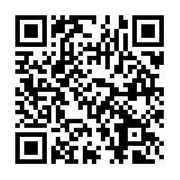
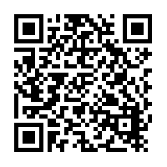
Amazon Wish List
Ms. C Chen Ms. Russo
Thank you for support!

